Slide 1
CPR E 281: Digital Logic
Md Maruf Ahamed
Office: 307 Durham Center
Phone: (515) 294-6323
Email: maruf@iastate.edu

Slide 2
Administrative Stuff
  Homework: HW#7 due on Sunday @ 11:59 PM
  Quiz: Quiz #7 due on Friday @ 4:25 PM
  Recitation: Recitation 7 this week
  Lab: Lab 7 this week
  Lecture-24 Readings: 5.8
  Midterm 2: Friday, April 1st @4:25 PM

Slide 3
23-T Flip-Flops and JK Flip-Flops
  Edge-triggered D flip-flop with Clear and Preset
  Flip-Flop Timing Parameters
  T Flip-Flop
    Positive-Edge-Triggered T Flip-Flop
    Negative-Edge-Triggered T Flip-Flop
  JK Flip-Flop
    Positive-Edge-Triggered JK Flip-Flop
    Negative-Edge-Triggered JK Flip-Flop

Slide 4
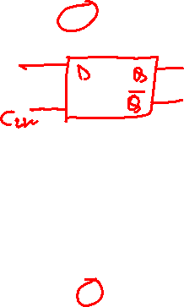
Negative-Edge-Triggered Master-Slave D Flip-Flop
Master
Slave
Q
Q
D
D
Q
m
D
Q
s
Q
D
Q
Clock
Clk
Q
Clk
Q
Q
Q
Positive-Edge-Triggered Master-Slave D Flip-Flop
Master
Slave
Q
Q
D
D
Q
m
D
Q
s
Q
D
Q
Clock
Clk
Q
Clk
Q
Q
Q

Slide 5
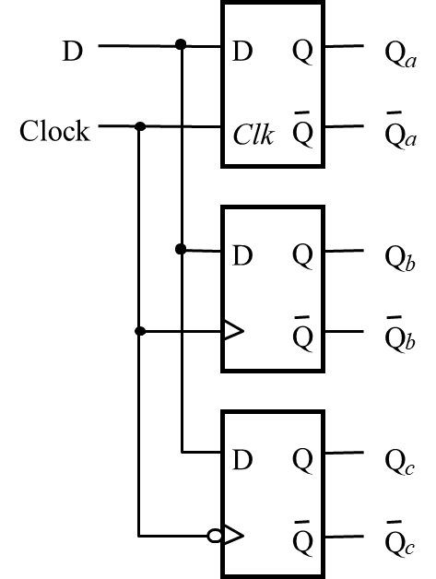
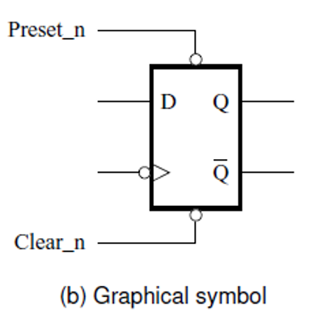
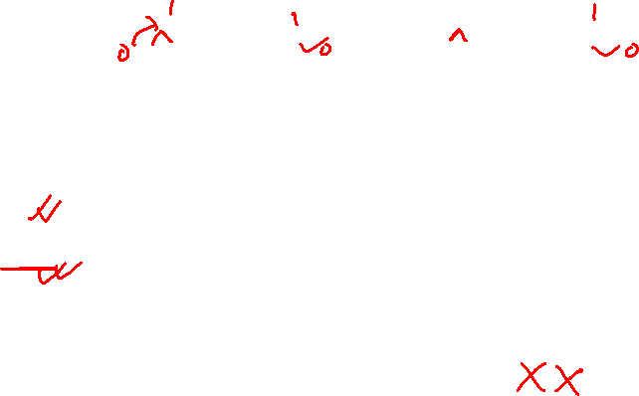
Comparison of level-sensitive and edge-triggered D storage elements
Clock
D
Q
a
Q
b
Q
c

Slide 6
T Flip-Flops & JK Flip-Flops
Readings 5.5, 5.6, 5.7

Slide 7
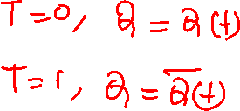
T Flip-Flop : Motivation
A slight modification of the D flip-flop that can be used for some nice applications.
In this case, T stands for Toggle.

Slide 8
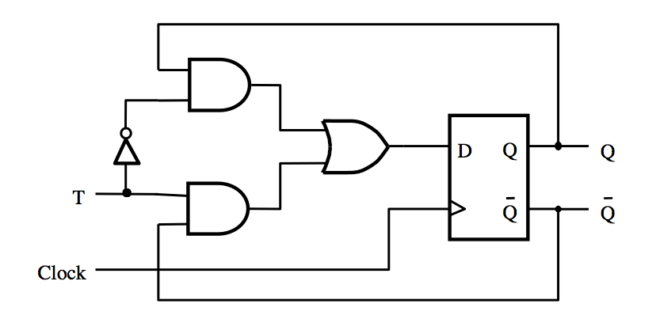
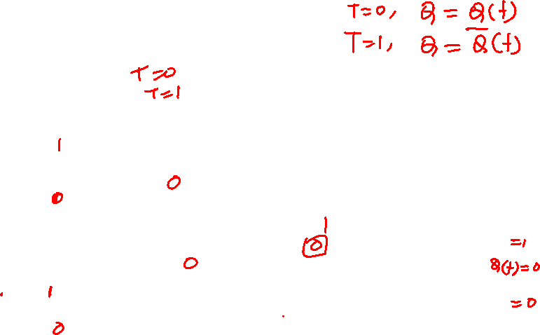
T Flip-Flop
[ Figure 5.15a from the textbook ]

Slide 9
T Flip-Flop
It is a 2-to-1 Multiplexer
Positive-edge-triggered
D Flip-Flop
[ Figure 5.15a from the textbook ]

Slide 10
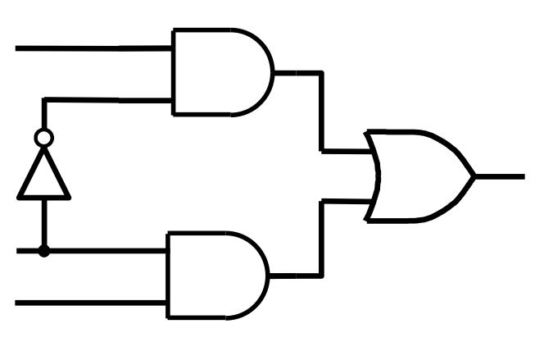
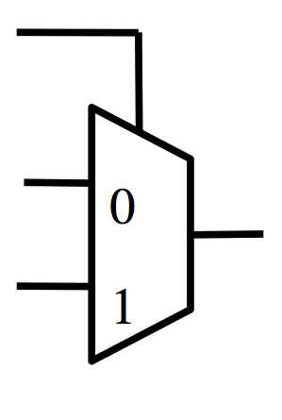
It is a 2-to-1 Multiplexer
Q
D
T
T
Q
Q
D
Q

Slide 11
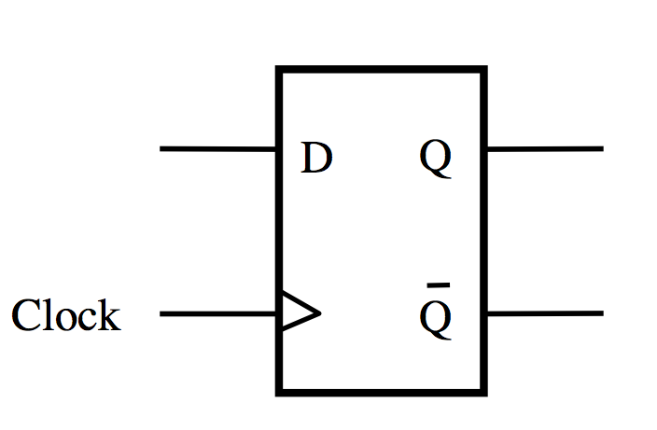
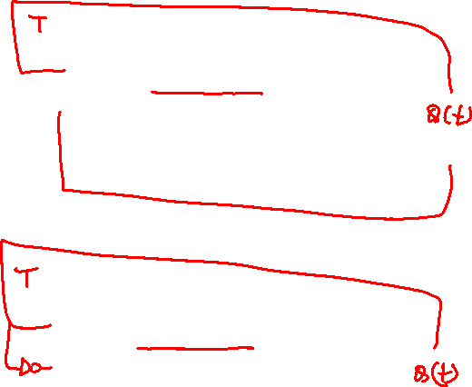
T Flip-Flop

Slide 12

T Flip-Flop
T
Q
0
D
Q
Q
1
Clock
Q
T
Q
0
D
Q
Q
1
Clock
Q
Note that the two inputs to the multiplexer are inverses of each other.

Slide 13
Another Way to Draw This
T
Q
0
D
Q
Q
1
Clock
Q
What is this?

Slide 14

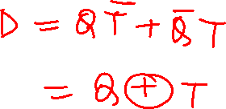
What is this?
Q
D
T

Slide 15
What is this?
Q
D
T
D = QT + QT

Slide 16
It is an XOR
Q
D
T
D = Q + T

Slide 17
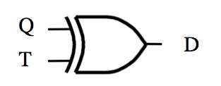
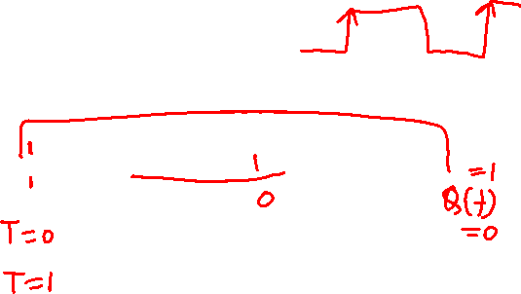
What is this?

Slide 18
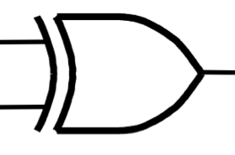
T Flip-Flop
T
D
Q
Clock
Q

Slide 19
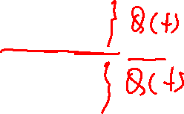
It is a T Flip-Flop too
T | Q | D
0 | 0 | 0
0 | 1 | 1
1 | 0 | 1
1 | 1 | 0
T
D
Q
Clock
Q

Slide 20
It is a T Flip-Flop too
T | Q | D
0 | 0 | 0
0 | 1 | 1
1 | 0 | 1
1 | 1 | 0
Q
T
D
Q
Q
Clock
Q

Slide 21
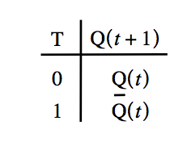
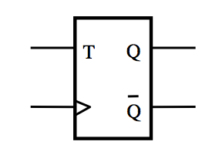

T Flip-Flop: (How it Works?)
If T=0, then it stays in its current state
If T=1, then it reverses its current state
In other words the circuit “toggles” its state when T=1. This is why it is called T flip-flop.

Slide 22
T Flip-Flop (circuit, truth table and graphical symbol)
T
D
Q
Clock
Q
[ Figure 5.15a-c from the textbook ]

Slide 23
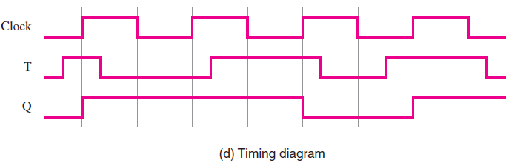
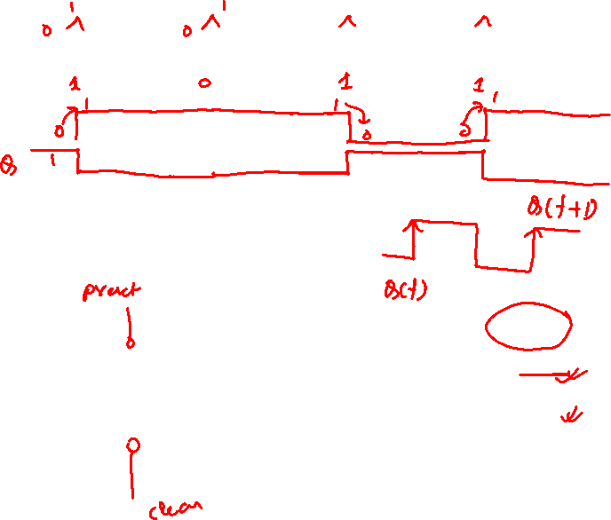
T Flip-Flop (Timing Diagram)
[ Figure 5.15d from the textbook ]

Slide 24
T Flip-Flop (Timing Diagram)
t₁ t₂ t₃ t₄
[ Figure 5.15d from the textbook ]

Slide 25
T Flip-Flop (Timing Diagram)
t₁ t₂ t₃ t₄
[ Figure 5.15d from the textbook ]

Slide 26
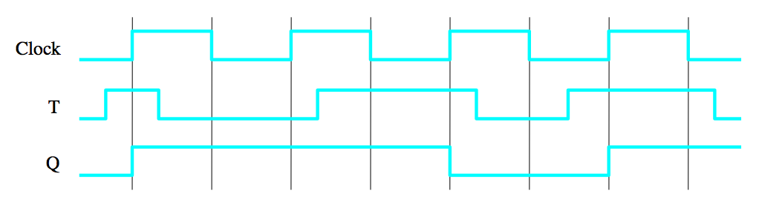
T Flip-Flop (Timing Diagram)
Decision Point
1
1
1
0
1
1
1
1
1
0
0
0
[ Figure 5.15d from the textbook ]

Slide 27
T Flip-Flop (Timing Diagram)
Decision Point
1
1
1
0
1
1
1
1
1
0
0
0
[ Figure 5.15d from the textbook ]

Slide 28
T Flip-Flop (Timing Diagram)
Decision Point
1
1
1
0
1
1
1
1
1
0
0
0
[ Figure 5.15d from the textbook ]

Slide 29
T Flip-Flop (Timing Diagram)
Decision Point
1
1
1
0
1
1
1
1
1
0
0
0
[ Figure 5.15d from the textbook ]

Slide 30
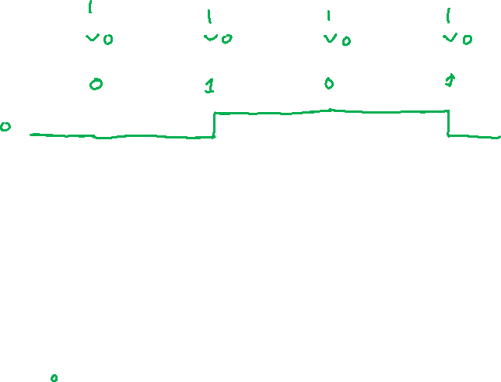
Negative-Edge-Triggered T Flip-Flop (Timing Diagram)
[ Figure 5.15d from the textbook ]

Slide 31
Negative-Edge-Triggered T Flip-Flop (Timing Diagram)
t₁ t₂ t₃ t₄
[ Figure 5.15d from the textbook ]

Slide 32
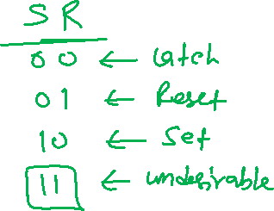
JK Flip-Flop

Slide 33
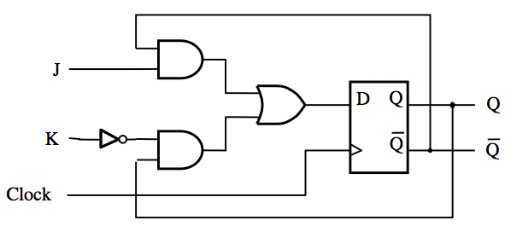

JK Flip-Flop
D = JQ + KQ
[ Figure 5.16a from the textbook ]

Slide 34
JK Flip-Flop
J
D
Q
Q
K
Q
Q
Clock
(a) Circuit
J
K
Q
(
t
+
1
)
0
0
Q
(
t
)
J
Q
0
1
0
1
0
1
K
Q
1
1
Q
(
t
)
(b) Truth table
(c) Graphical symbol
[ Figure 5.16 from the textbook ]

Slide 35
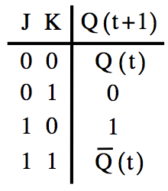
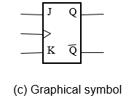

JK Flip-Flop (How it Works?)
A versatile circuit that can be used both as a SR flip-flop and as a T flip flop.
If J=0 and k =0 it stays in the same state
Just like SR, it can be set and reset
J=S and K=R
If J=K=1 then it behaves as a T flip-flop

Slide 36
JK Flip-Flop (How it Works?)
A versatile circuit that can be used both as a SR flip-flop and as a T flip flop.
If J=0 and k =0 it stays in the same state
Just like SR, it can be set and reset
J=S and K=R
If J=K=1 then it behaves as a T flip-flop

Slide 37
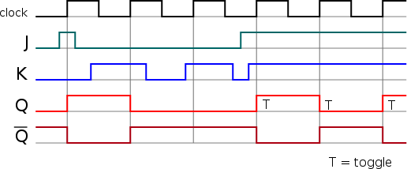
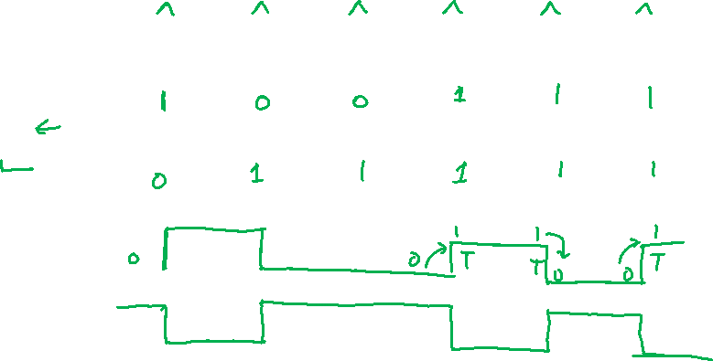
JK Flip-Flop (timing diagram)
t₁ t₂ t₃ t₄ t₅ t₆

Slide 38
JK Flip-Flop (timing diagram)
t₁ t₂ t₃ t₄ t₅ t₆

Slide 39
Complete Wiring Diagrams

Slide 40
Positive-Edge-Triggered D Flip-Flop
Negative-Edge-Triggered D Flip-Flop

Slide 41
Positive-Edge-Triggered D Flip-Flop
D
Q
Clock
Q
Negative-Edge-Triggered D Flip-Flop
D
Q
Clock
Q

Slide 42
Positive-Edge-Triggered T Flip-Flop
T
D
Q
Clock
Q
Negative-Edge-Triggered T Flip-Flop
T
D
Q
Clock
Q

Slide 43
Positive-Edge-Triggered T Flip-Flop
T
Q
Clock
Q
Negative-Edge-Triggered T Flip-Flop
T
Q
Clock
Q

Slide 44
Positive-Edge-Triggered JK Flip-Flop
J
D
Q
Q
K
Q
Q
Clock
Negative-Edge-Triggered JK Flip-Flop
J
D
Q
Q
K
Q
Q
Clock

Slide 45
Positive-Edge-Triggered JK Flip-Flop
J
Q
K
Clock
Q
Negative-Edge-Triggered JK Flip-Flop
J
Q
K
Clock
Q

Slide 46

END Slide

